Slide 1
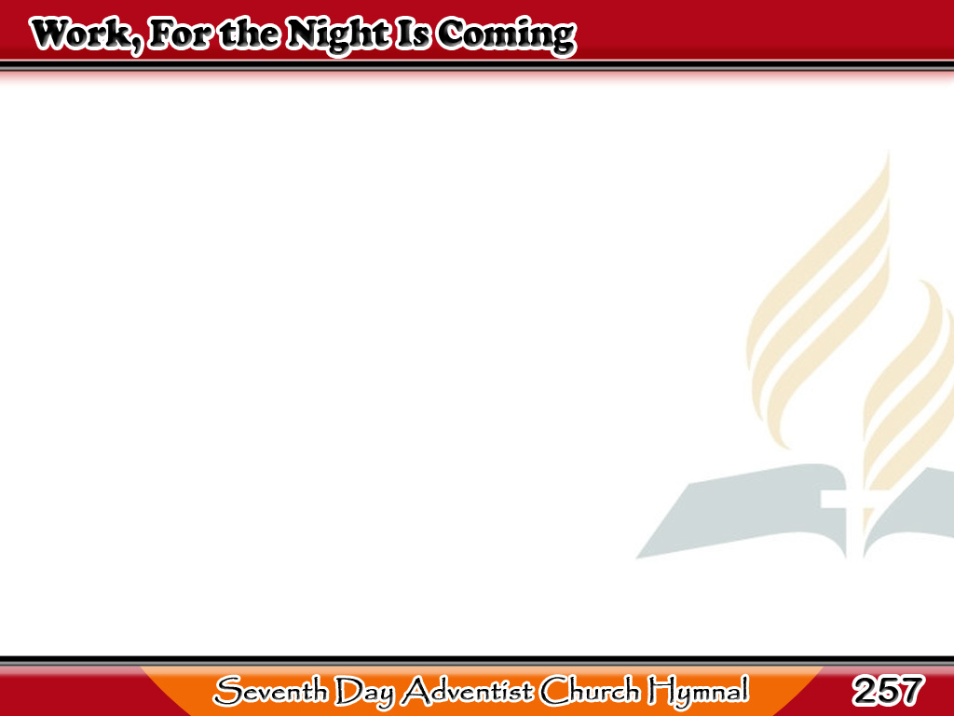
Samantalang Maaga
Work, for the night is coming;
Work through the morning hours;
Work while the dew is sparkling;
Work ‘mid springing flowers;
1/3

Slide 2
Samantalang Maaga
Work while the day
grows brighter,
Under the glowing sun;
Work, for the night is coming,
When man’s work is done.
1/3

Slide 3
Samantalang Maaga
Work, for the night is coming;
Work through the sunny noon;
Fill brightest hours with labor,
Rest comes sure and soon;
2/3

Slide 4
Samantalang Maaga
Give every flying minute
Something to keep in store;
Work, for the night is coming,
When man woks no more.
2/3

Slide 5
Samantalang Maaga
Work, for the night is coming;
Under the sunset skies,
While their bright tints
are glowing,
Work for daylight flies;
3/3

Slide 6
Samantalang Maaga
Work till the last beam fadeth,
Fadeth to shine no more;
Work, for the Lord is coming,
When man’s work is o’er.
3/3

